Slide 1
Oregon State University NASA USLI
12/14/2017

Slide 2
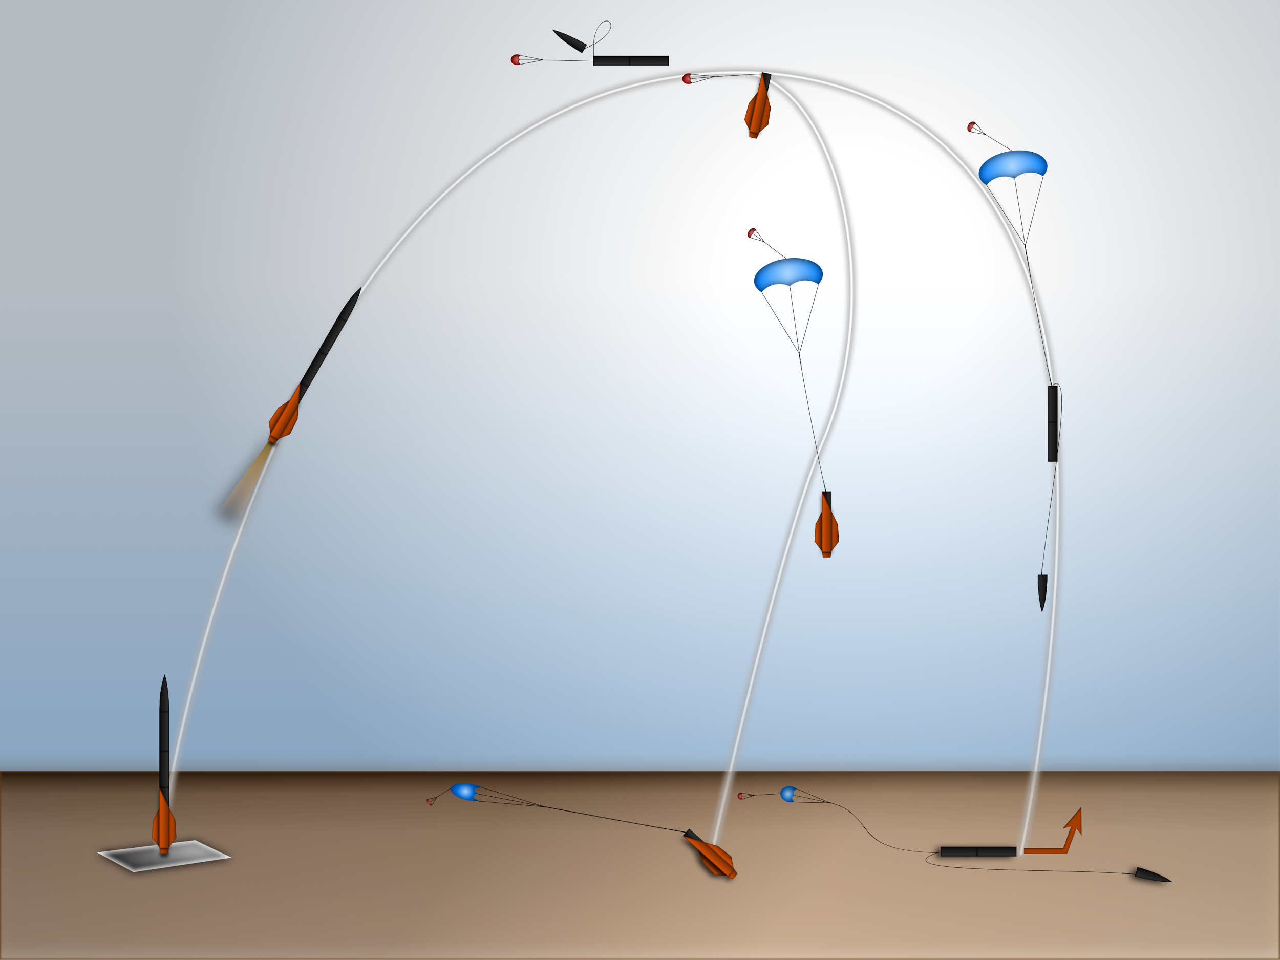

Slide 3
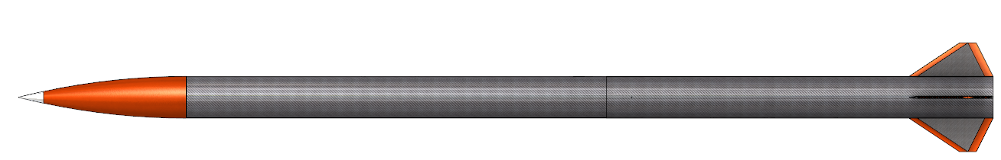
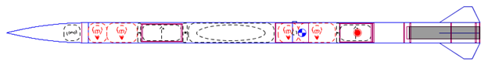
Structural Overview
45.2 lbs. at launch
5.4” diameter
116” (9.7 ft.) length
Estimated Altitude: 5,900 ft.

Slide 4
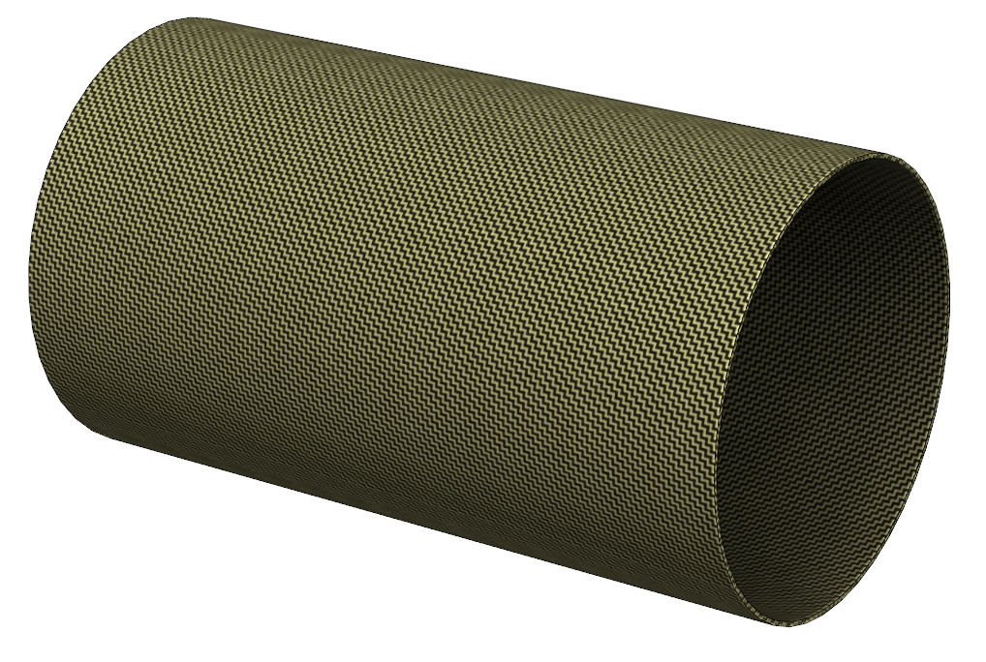
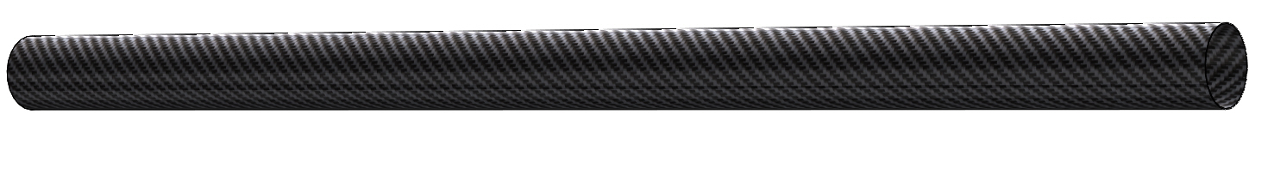
Body Materials
Carbon Fiber Airframe
2 sections, 50” (4.2 ft.) and 46” (3.8 ft.)
Fiberglass Coupler Tubes
2 coupler sections, 8” each

Slide 5
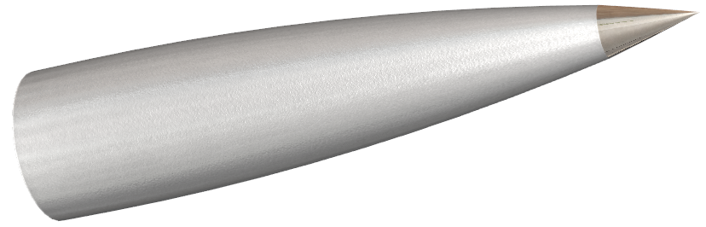
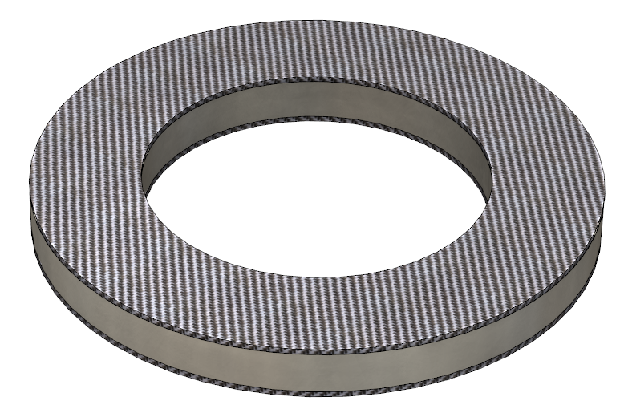
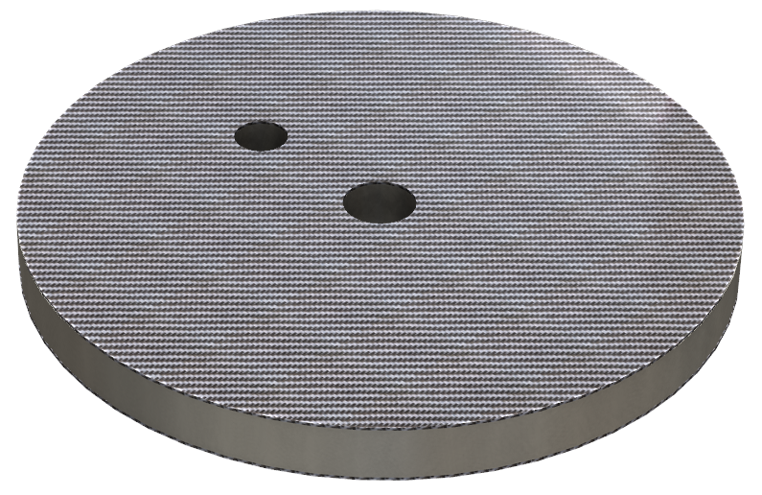
Nosecone and Bulkheads
Nosecone:
Fiberglass with aluminum tip
5 Bulkheads, 2 Centering Rings
Carbon fiber and Nomex
0.38” Nomex
0.024” carbon fiber

Slide 6
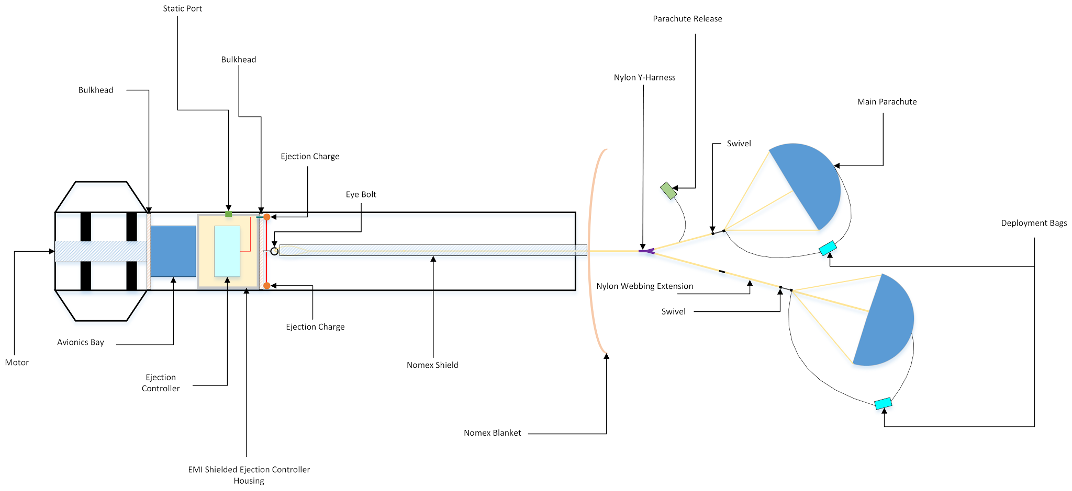
Recovery Overview: Aft Section

Slide 7
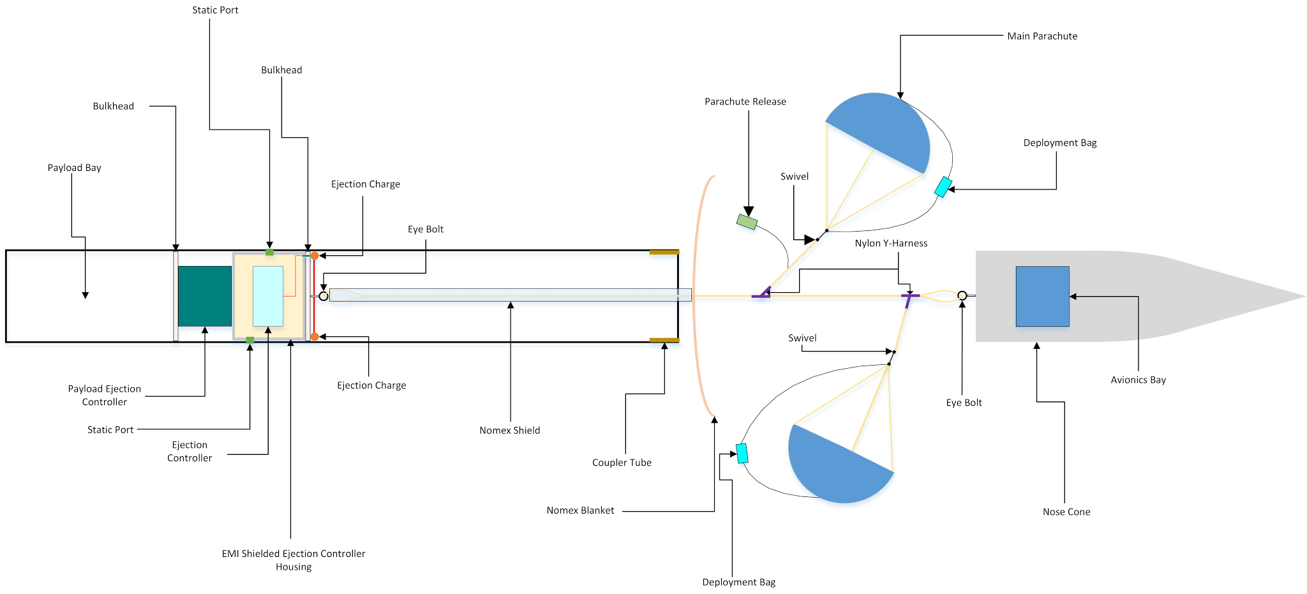
Recovery Overview: Fore Section

Slide 8
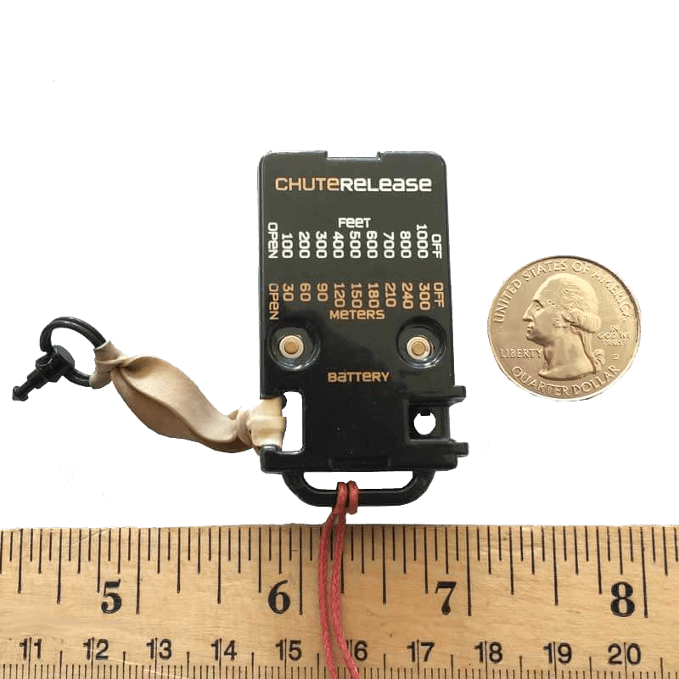
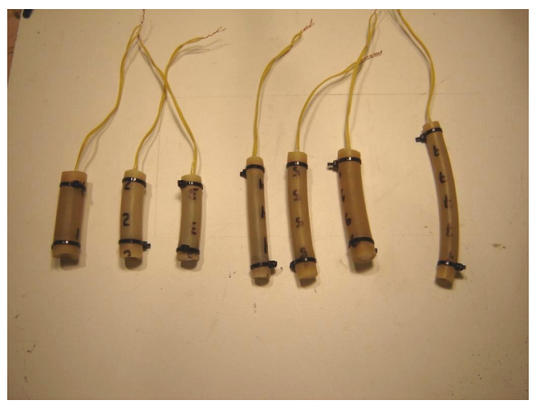
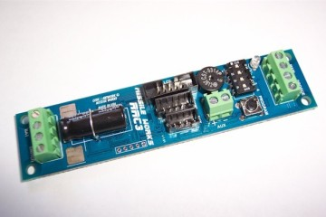
Aerodynamics/Recovery: Ejection
Black Powder Ejection Charges
Separation: Missile Works RRC3
Parachute Release: Jolly Logic Chute Release

Slide 9
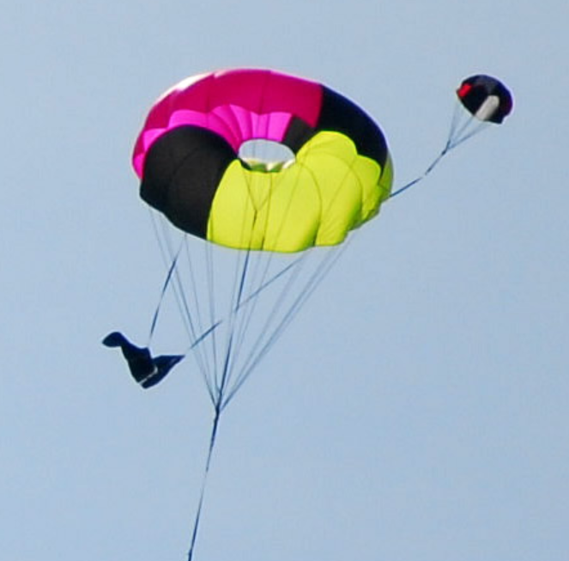
Aerodynamics/Recovery: Parachutes
Drogue Velocities: ~130 ft/s
Main Velocities: ~13 ft/s

Slide 10
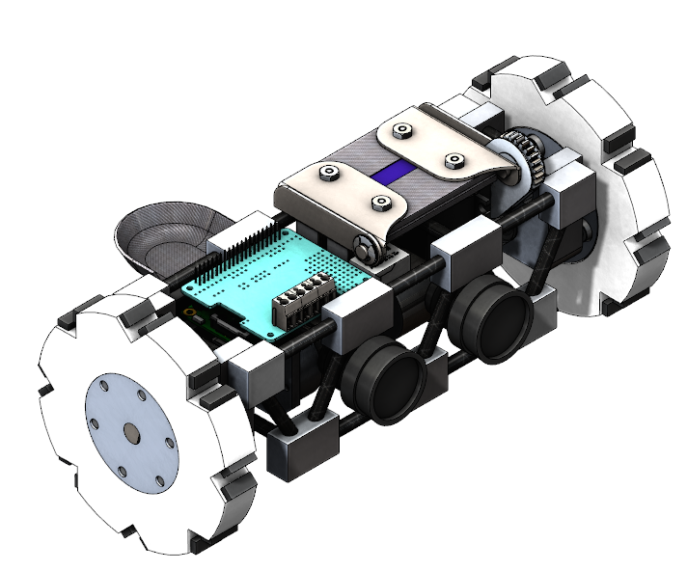
Rover Payload: Overview
Technical Specifications
5.05 pounds
4.9 inches in diameter
3 ft/s top speed
10.625 inches long

Slide 11
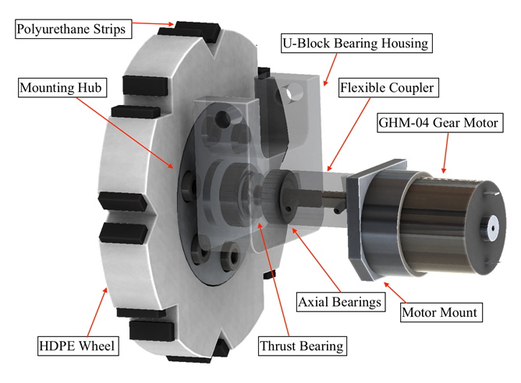
Rover Payload: Drive Train
7.81 lbs.-in. max torque
Carbon fiber axle
¾” thick HDPE wheel
Load dissipation from wheel through U-block

Slide 12
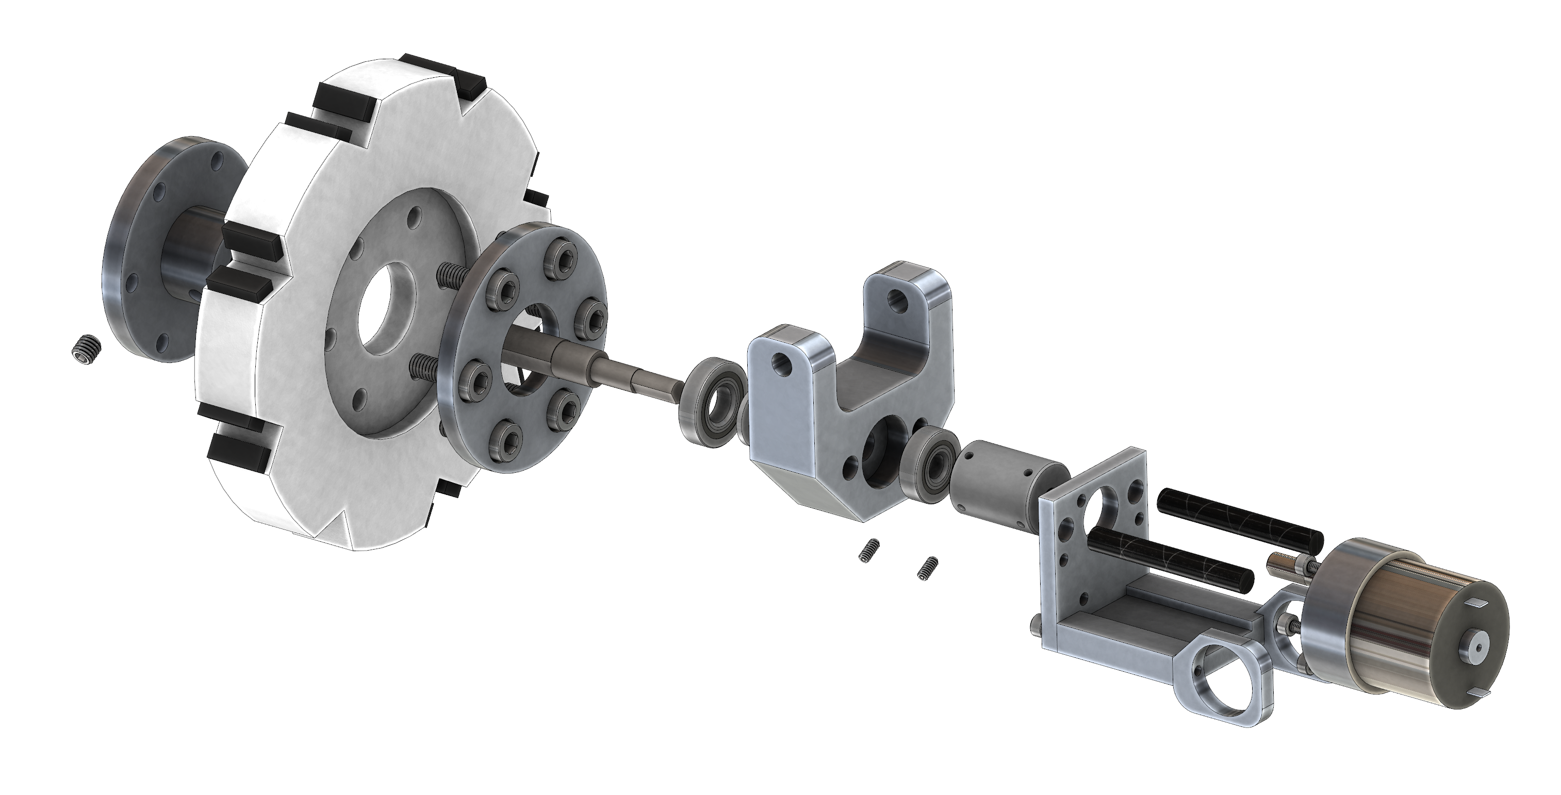

Slide 13
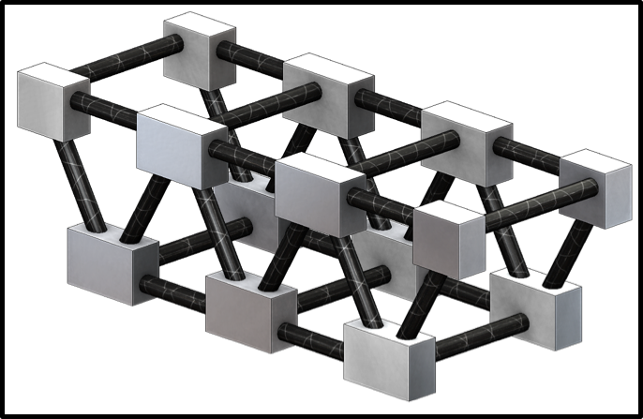
Rover Payload: Chassis
0.25” carbon-fiber rods
Aluminum joints
Drivetrain and electronics attached inside
High compressive strength

Slide 14
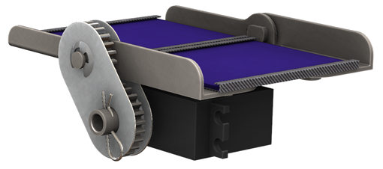
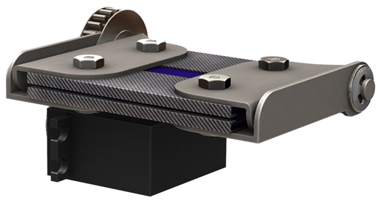
Rover Payload: Solar Deployment

Slide 15
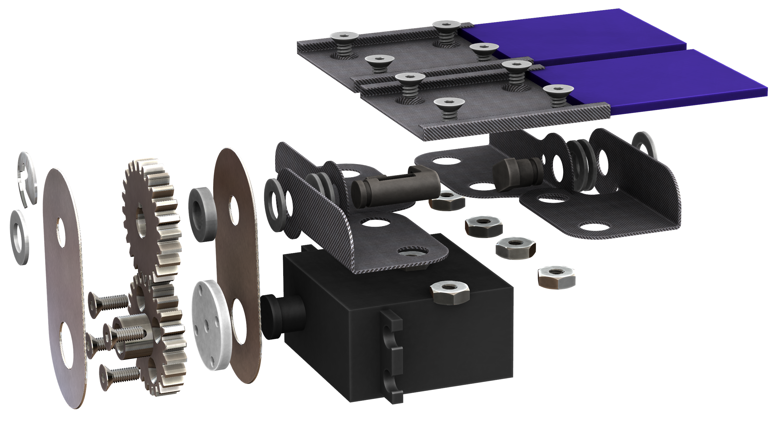
Rover Payload: Solar Deployment

Slide 16
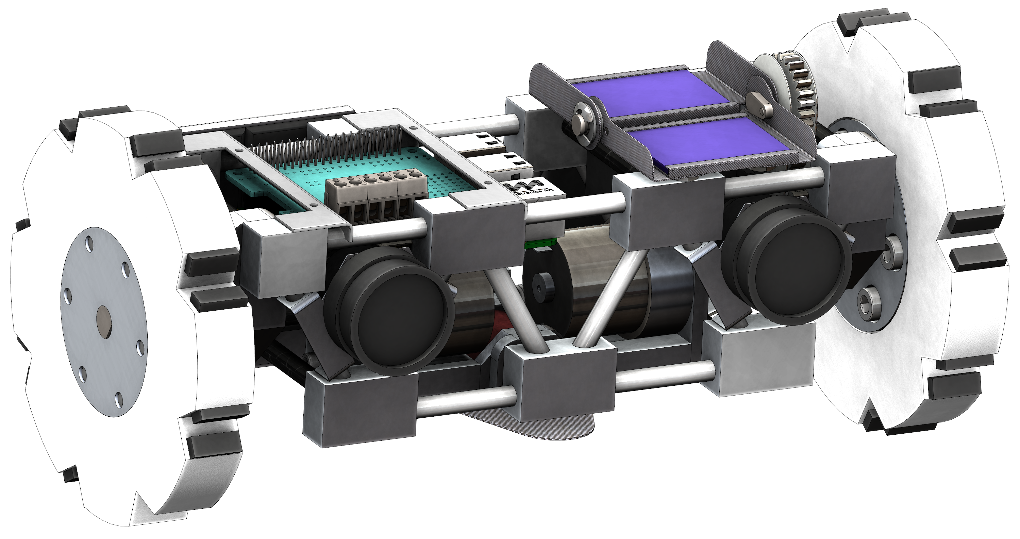

Slide 17
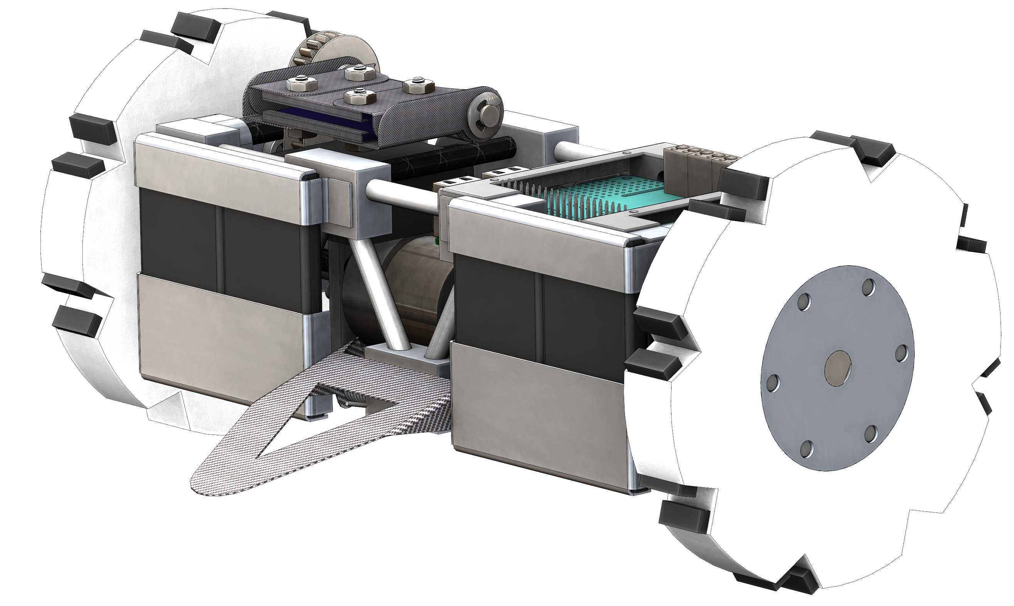

Slide 18
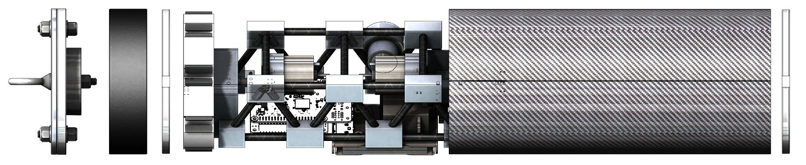
Rover Payload: Ejection
Black powder ejection upon landing

Slide 19
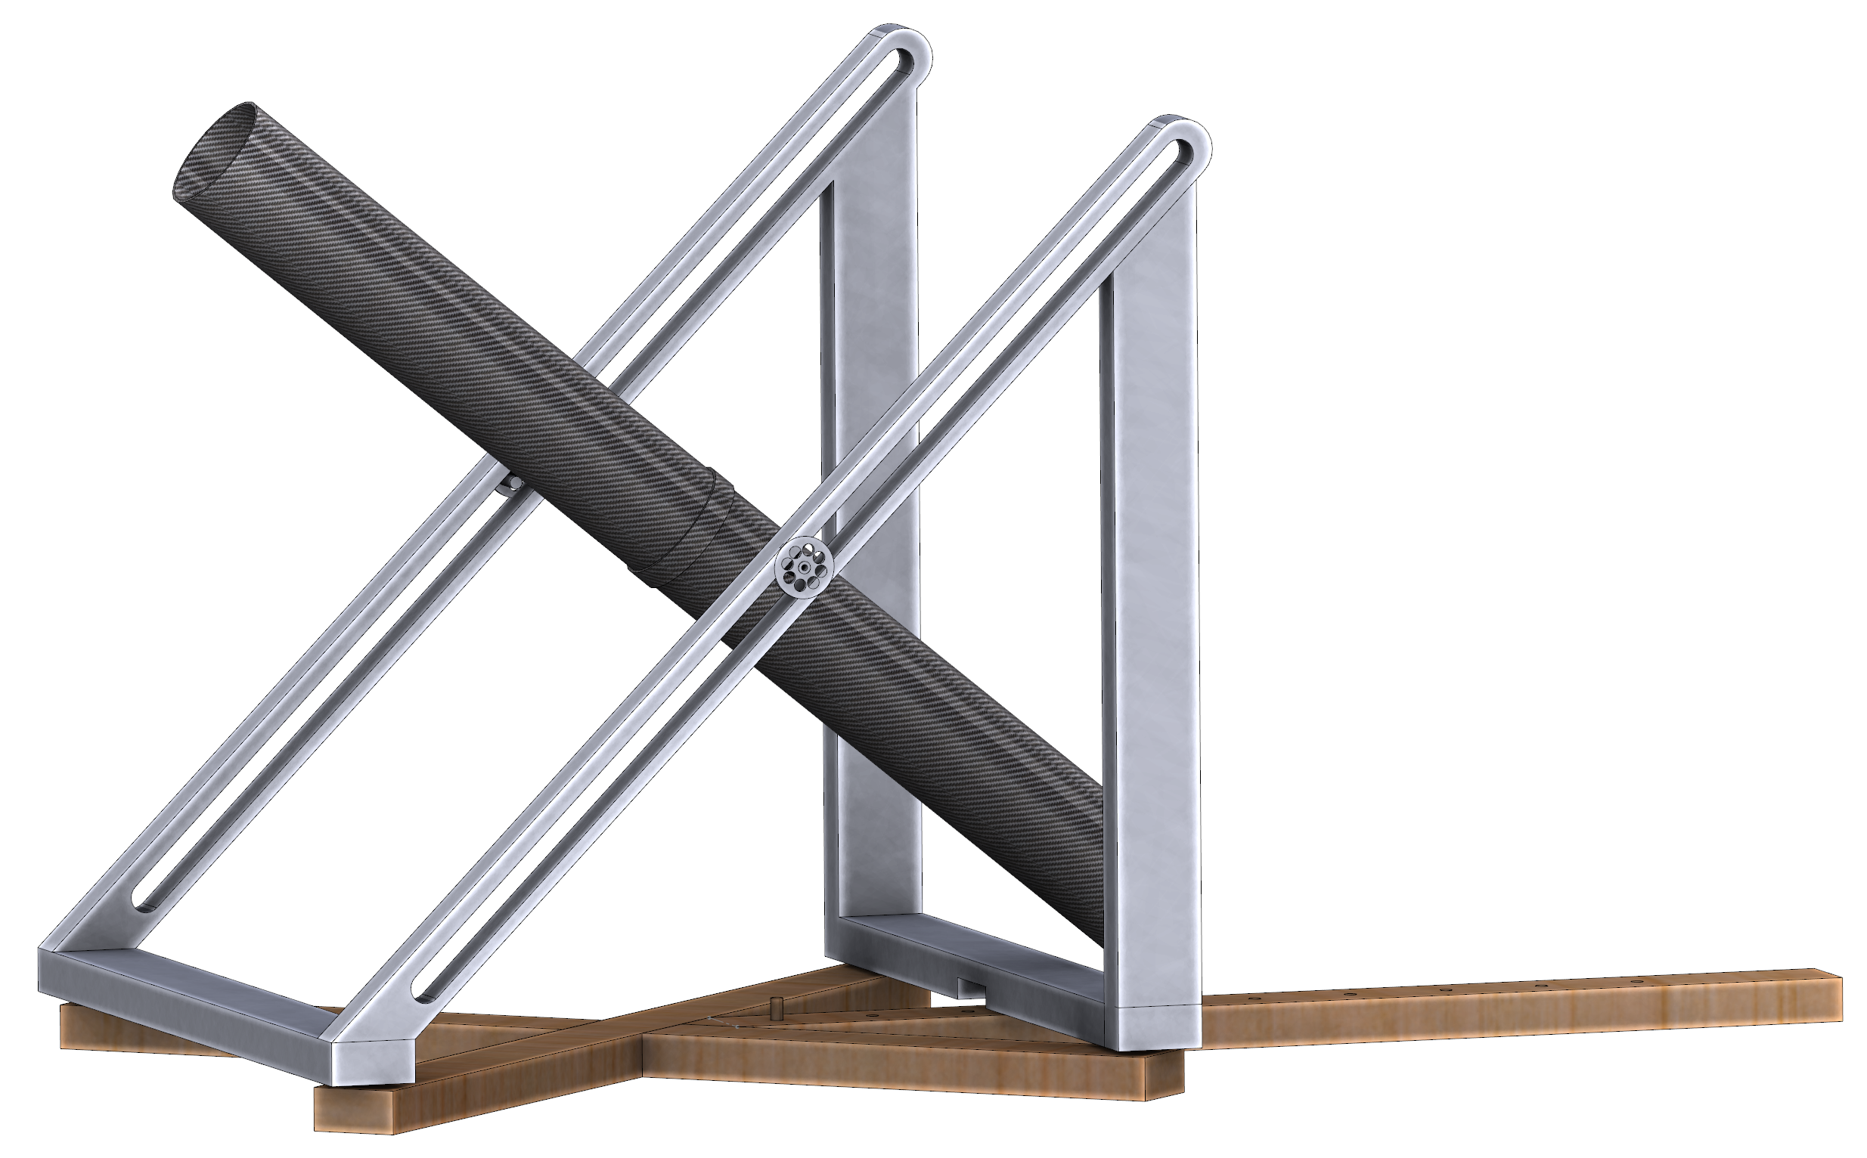
Rover Payload: Ejection Testing

Slide 20
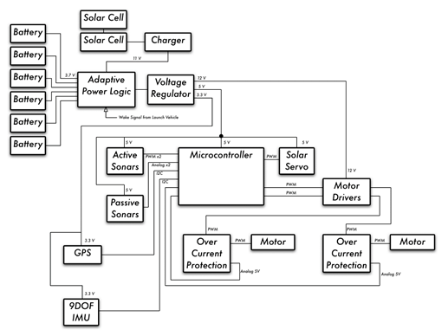
Rover Payload: Electronics

Slide 21
Questions?

Slide 22
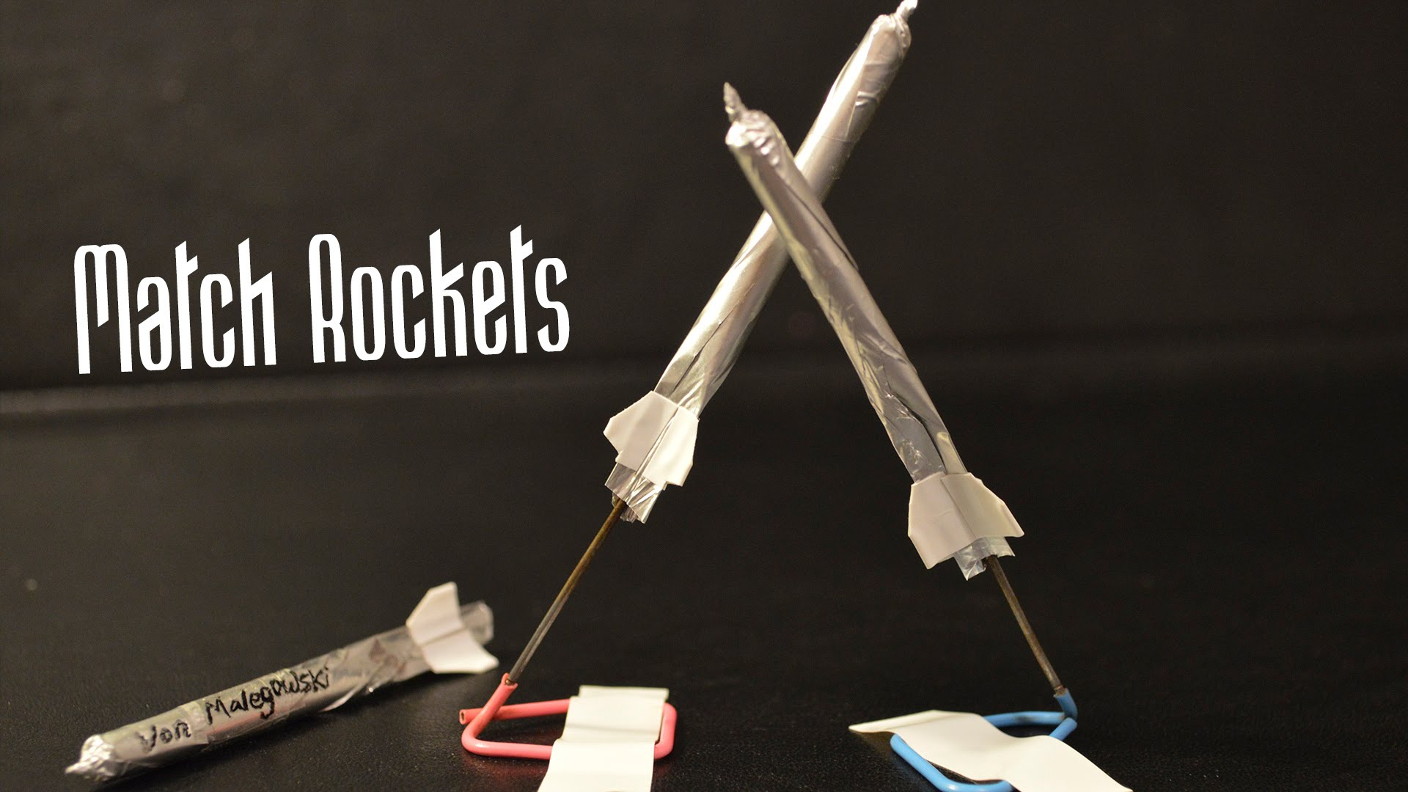
Match Rockets
Newton’s Third Law of Motion
Action – Combustion
Re-Action – products (hot gas and smoke) create movement
Newton’s Second
Law of Motion
Force (thrust) is the product of
mass escaping and its acceleration

Slide 23
Match Rockets
Instructions
Cut two square of Aluminum foil (one body length, second much smaller)
Roll the large square over a thin circular body until it’s a tube
Gently pinch down one side and wrap the smaller square around it. (this will be your nosecone)
Fins are optional, but recommended. Cut a square piece of tape, poke a hole in the center and slide the rocket through the hole. Pinch the tape to create the fins. Cut off excess.

Slide 24
Match Rockets
Instructions
Cut the tips off the matches. Only one to two match heads per rocket. Gently load and push toward the top.
Slide rocket onto paperclip stand and pinch down the exhaust port around the clip but still able to slide.
Stand back and allow one of the staff to light your rocket.

Slide 25
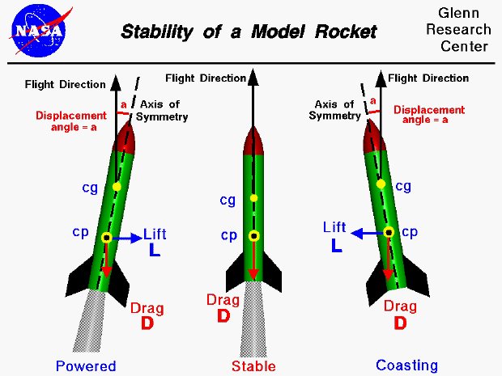
Aerodynamics
Rocket aerodynamics is the study of how air flows over a rocket and how this affects drag and stability.
Nose cone and Fins => Designed to:
Minimize drag
Provide stability
Provide control

Slide 26
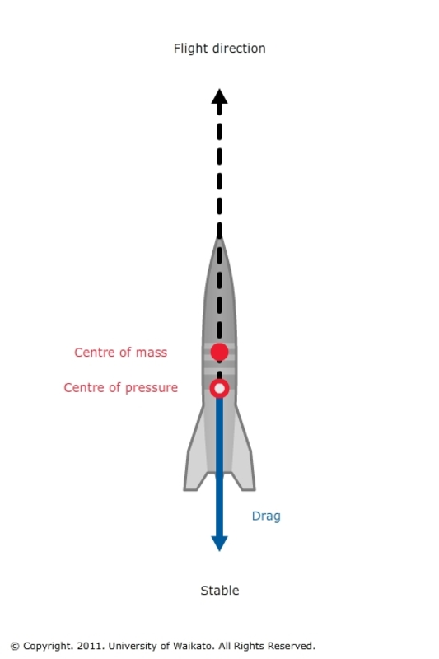
Aerodynamics
Stability in a rocket depends on the center of pressure
being lower than the center of mass or the rocket
will tumble.
increased distance = increased stability
Fins at the bottom of the rocket moves the center
of pressure down, but adds drag.
Finding the balance is the key.

Slide 27
Paper Cone Flights
Instructions
Take you paper cone, add some playdough as a balancing weight inside the cone.
Create paper fins and try and achieve a stable decent

Slide 28
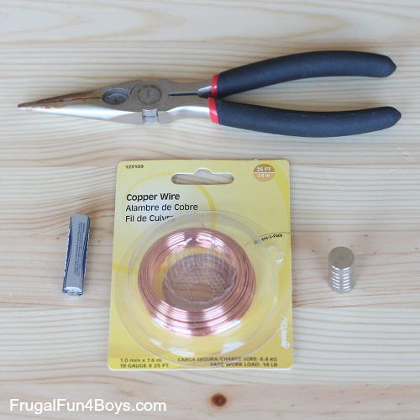
Electro-magnetic Train
Wire Cutters
Copper Wire Coil
AAA Battery
Neodymium Magnets (Caution very strong)

Slide 29
Electro-magnetic Train
Instructions
Take the two Neodymium magnets and flip them so that they repel each other and place the AAA battery between.
Insert into the copper coil and give slight push and watch your train leave.

Slide 30
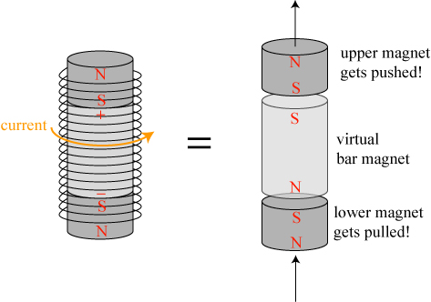
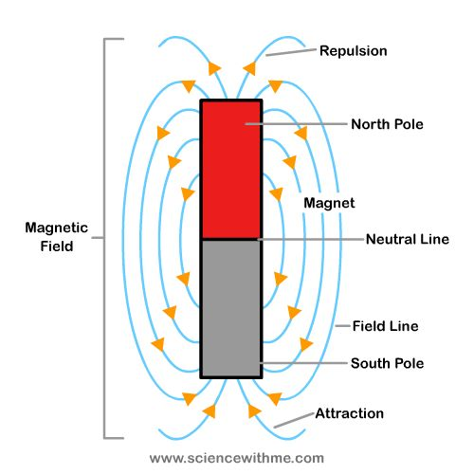
Electro-magnetic Train

Slide 31
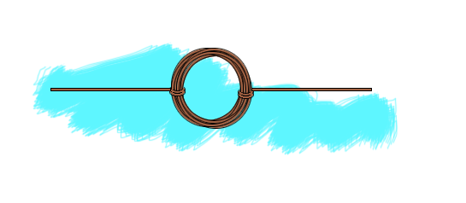
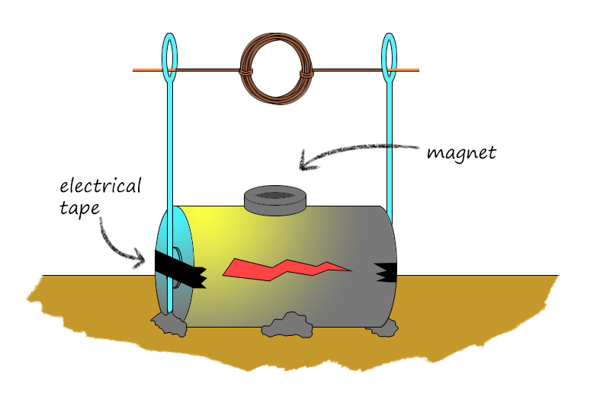
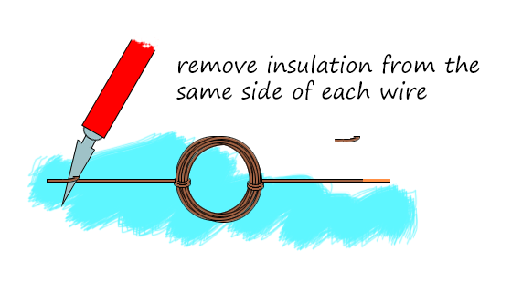
Electric Motor

Slide 32
Electric Motor

